Slide 1
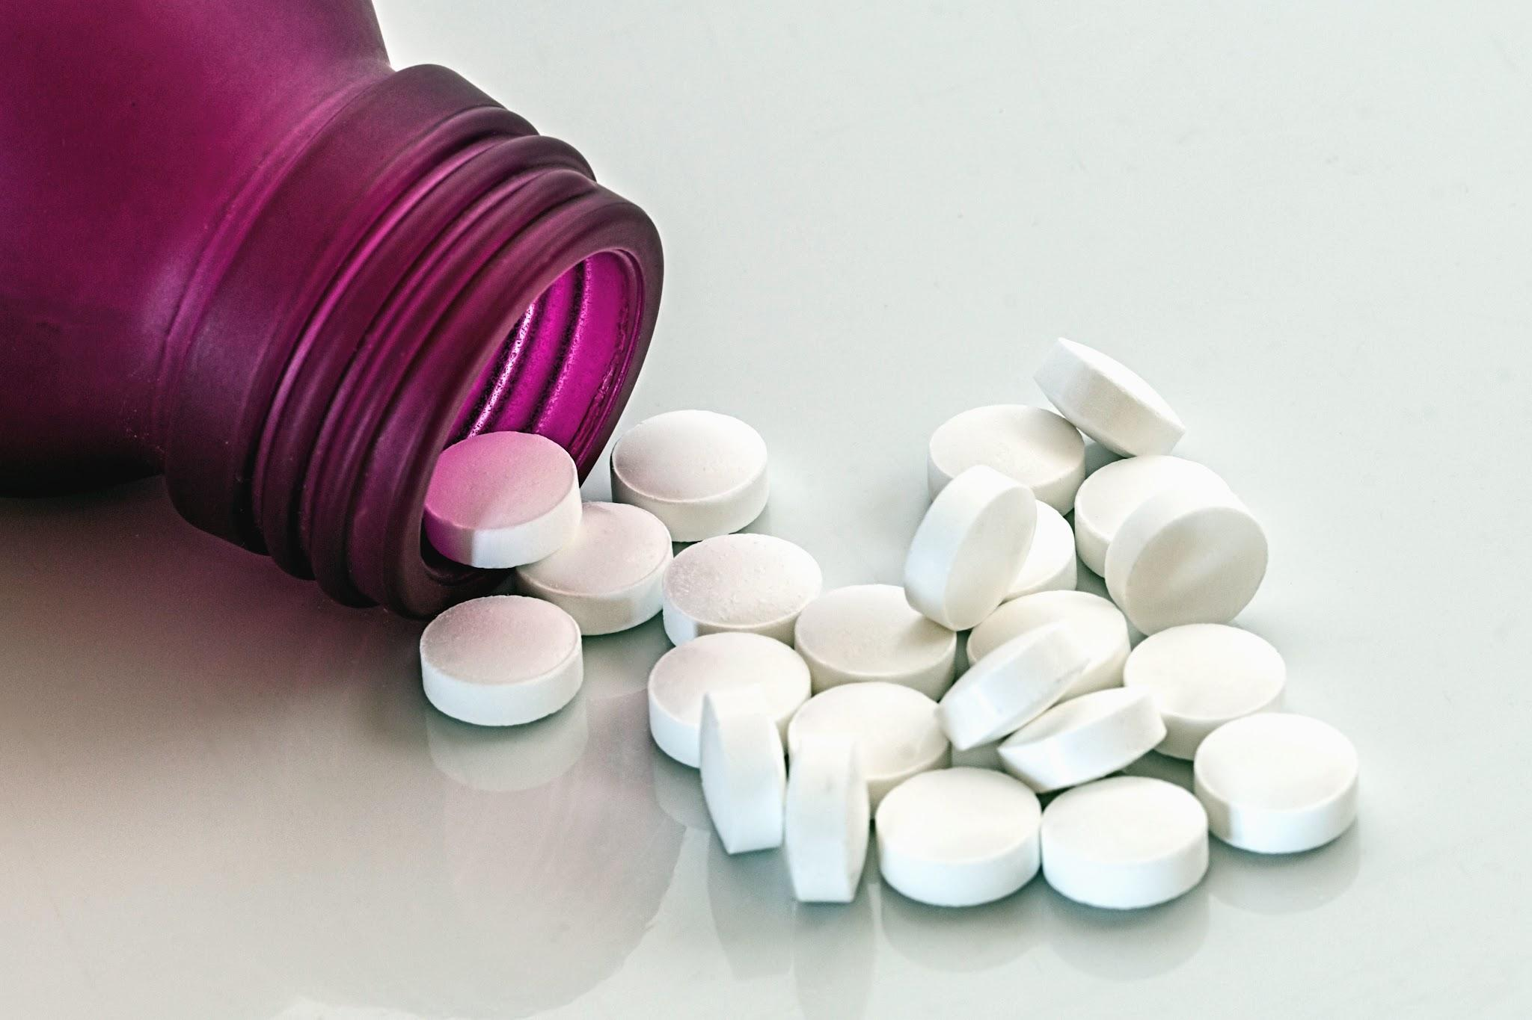
Data-Driven Decisions: Enhancing Pharmacy Operations with Sales Insights
Machine Learning/Time Series Business Analysis on Sales Data
By: Daniel Wang

Slide 2
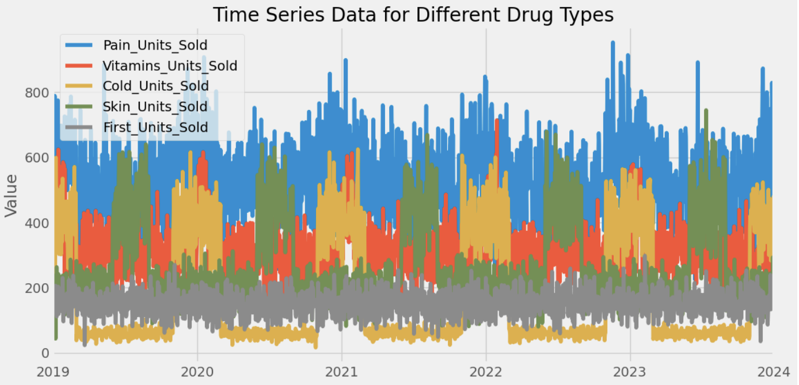
Historical Data
Key insights:
Pain Relievers are the most popular, with sales peaking in winter.
First aid units are least popular overall with no obvious seasonality.
Vitamins and cold remedies peak in winter months, with cold remedies being very unpopular outside of winter months.

Slide 3
Methods Used for Time Series Analysis
Prophet Model
Analyzes past patterns in units sold, like seasonality (e.g., holidays, weekends) and sudden, unexpected changes.
Used to make predictions and gain insight into which how different temporal components(month, day, etc.) affect units sold.
XGBoost
Derived from a general classification machine learning model (decision trees), uses ‘if-then’ rules to learn past trends and predict the future.
Used to find feature importances, or how important each temporal component is in predicting units sold.
After model optimization, both models had similar error rates, so we’ll gather insight from both models.

Slide 4
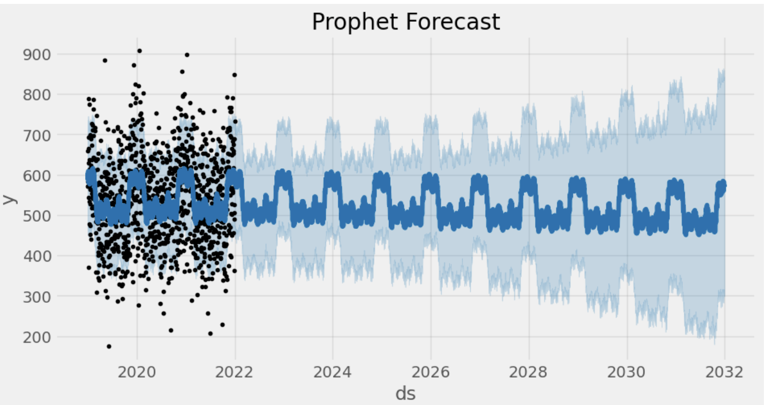
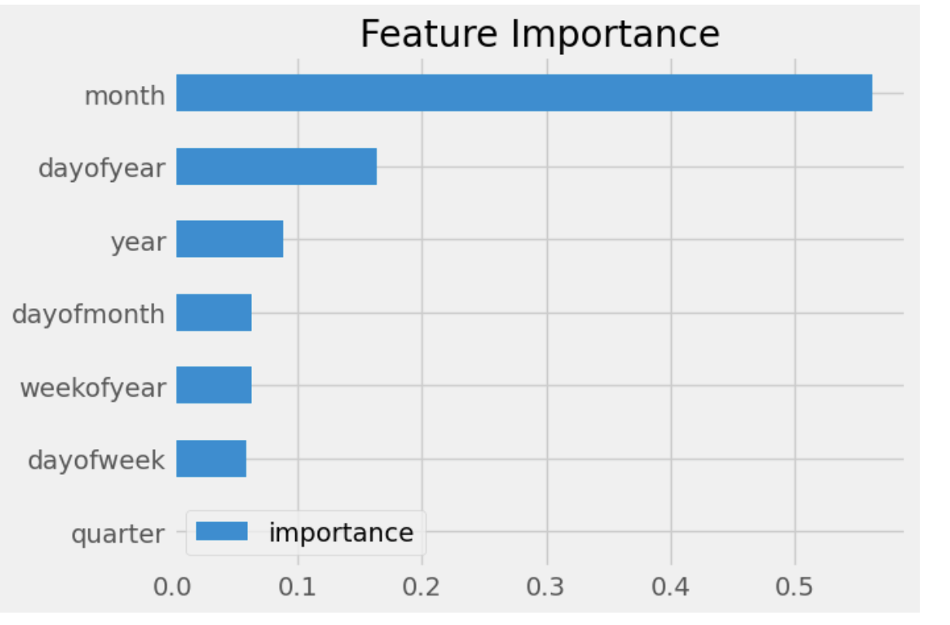
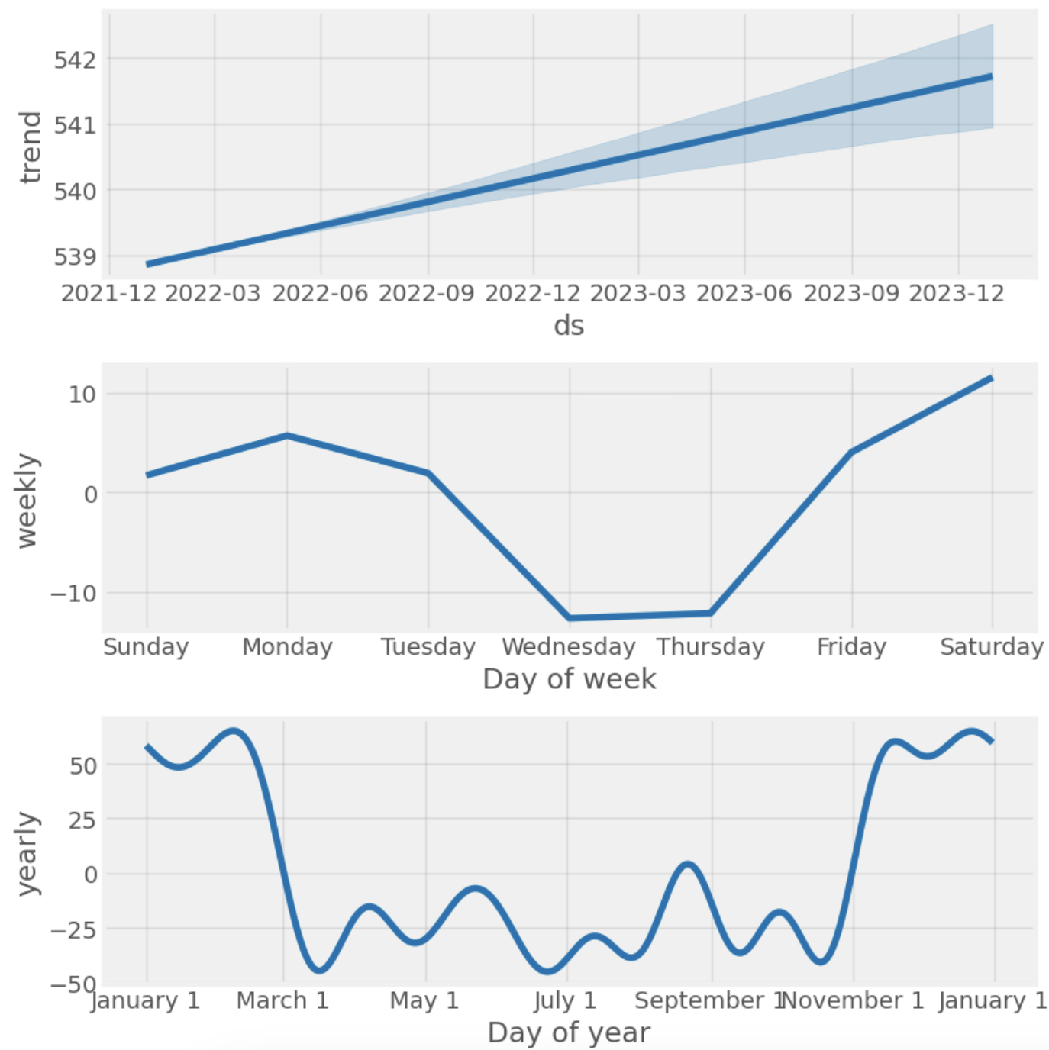
Pain Relievers Analysis
A Deeper Dive
Ten- Year Forecast
Best Predictor of Units Sold
There is a slight positive trend which signifies overall growth in sales. Seasonality analysis highlights rise in sales during winter months.
02
Annual sales is projected to remain consistent within the next ten years, with sales spiking in winter months.
Months is clearly the most important predictor for how many units of pain relievers sold.

Slide 5
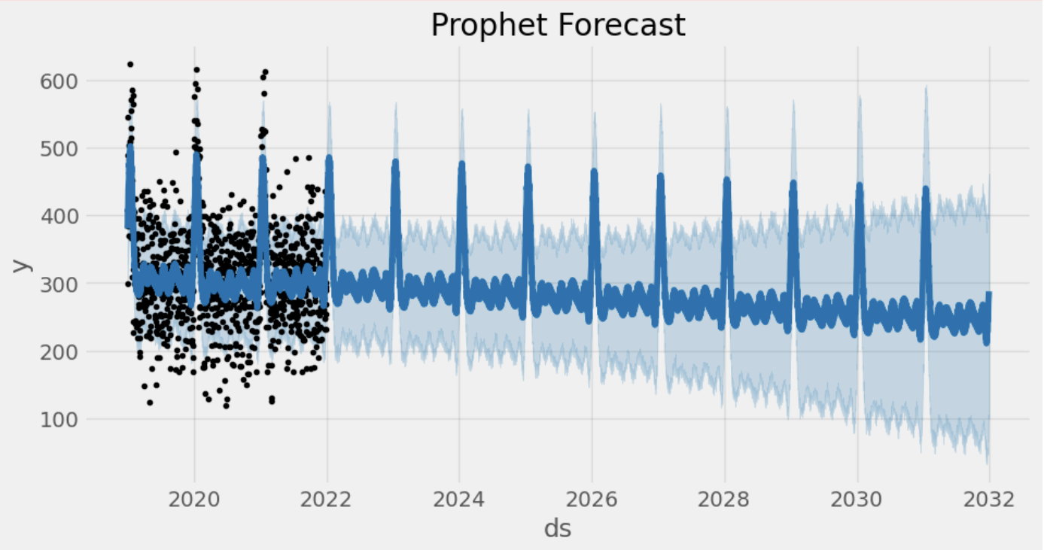
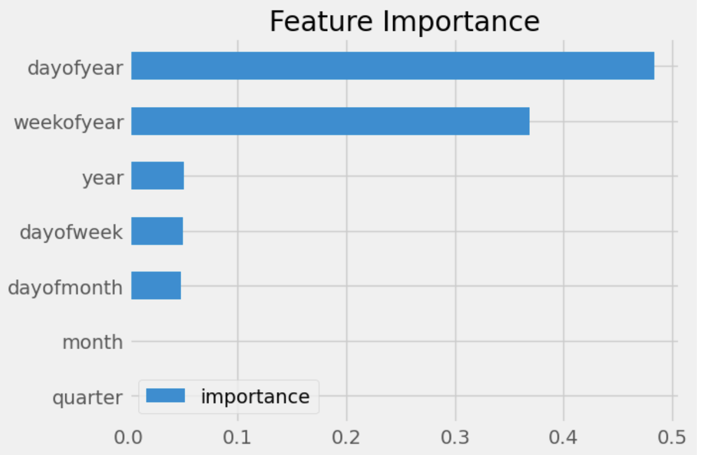
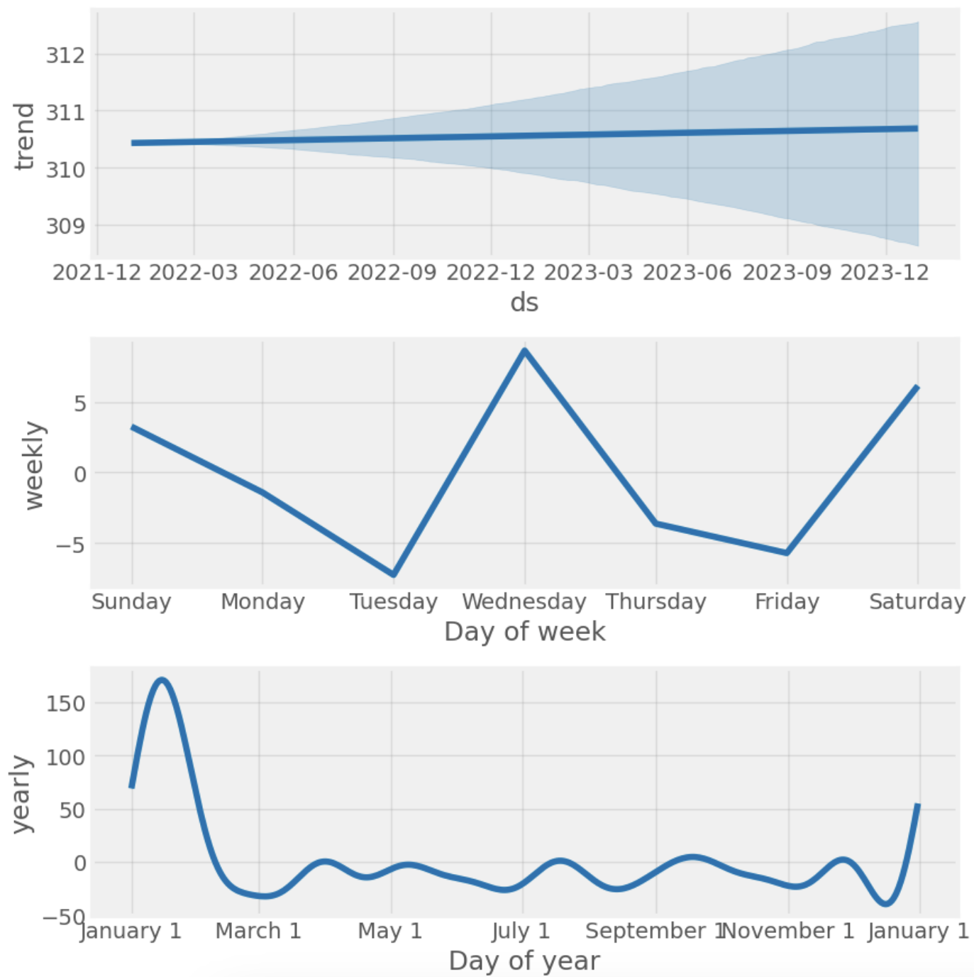
Vitamins
A Deeper Dive
Ten Year Forecast
Best Predictor of Units Sold
There is a static trend which demonstrates stagnation in sales. Seasonality analysis highlights rise in sales during New Years.
02
Annual sales are projected to decrease annually within the next ten years, with the trend of sales peaking at the beginning of each year being consistent.
Day of Year(e.g. Day 1 out of 365) is the best predictor. Analysis suggests the closer the day is to the New Year, the more sales will occur.

Slide 6
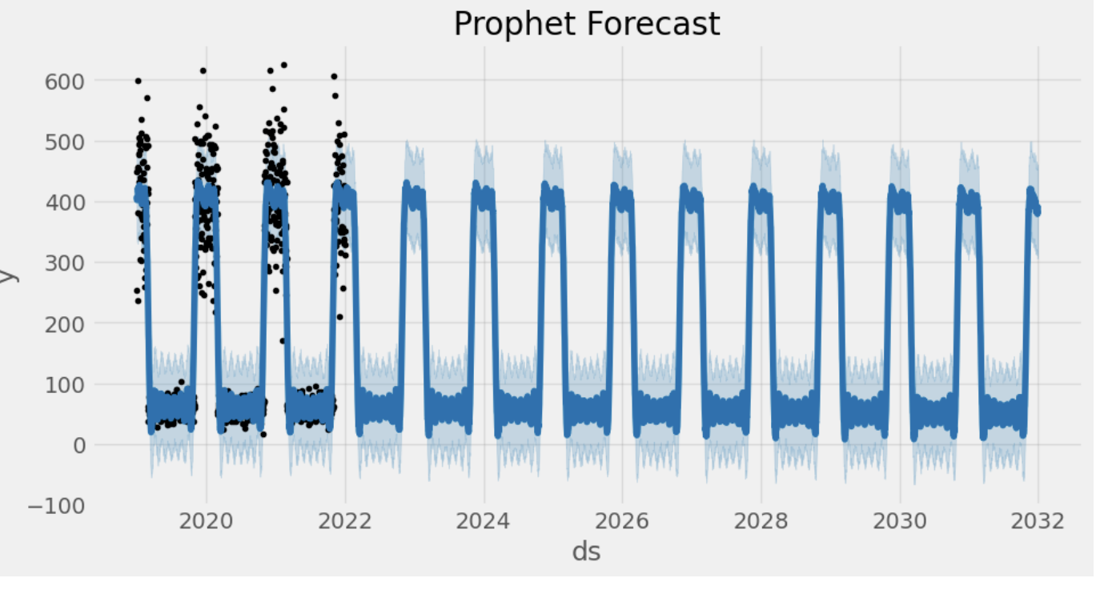
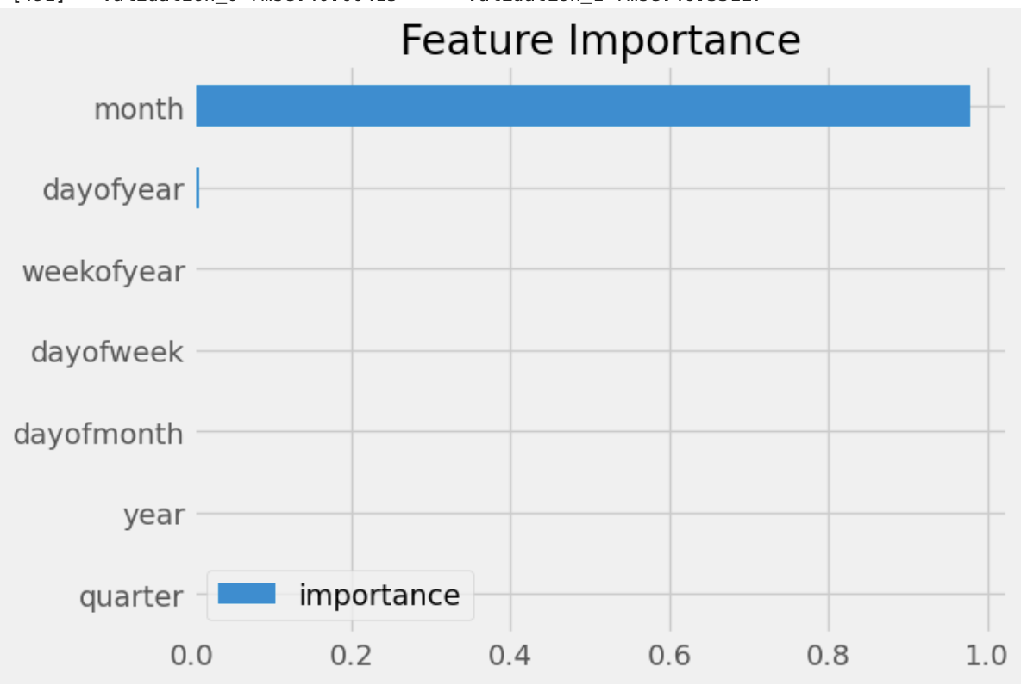
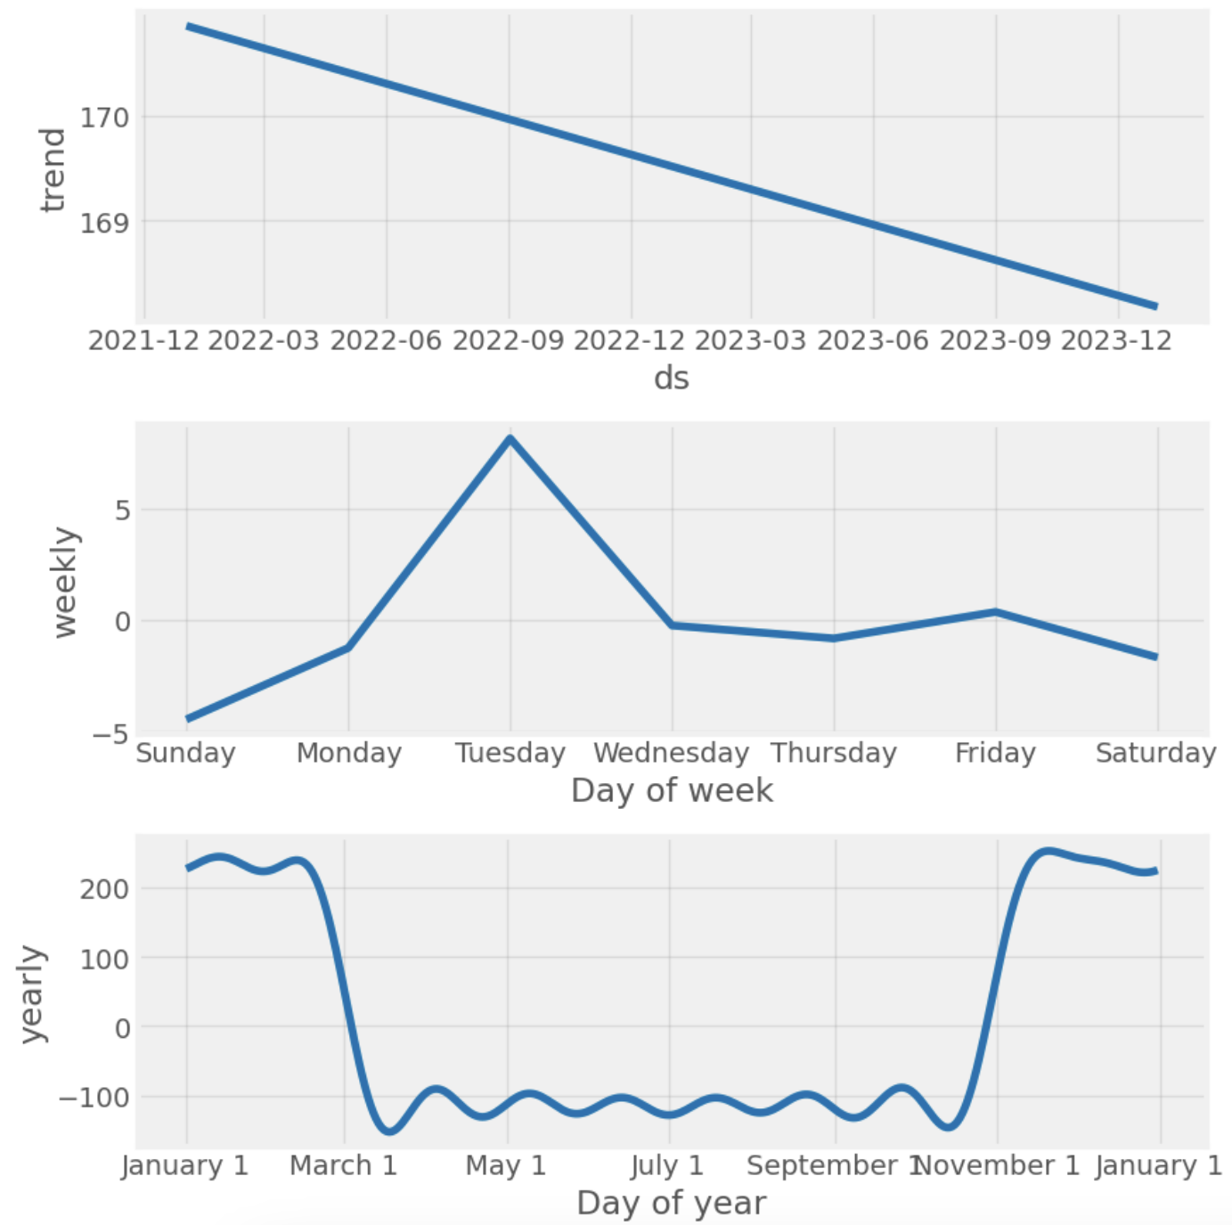
Cold Remedies
A Deeper Dive
Ten-Year Forecast
Best Predictor for Units Sold
There is a slight negative trend which demonstrates decrease in sales. Seasonality analysis highlights rise in sales during winter months.
02
Annual sales are projected to remain constant within the next ten years, with the trend of sales peaking during winter being consistent.
Month of Year is the best predictor. Analysis suggests winter months(November- January) result in a huge uptick in sales.

Slide 7
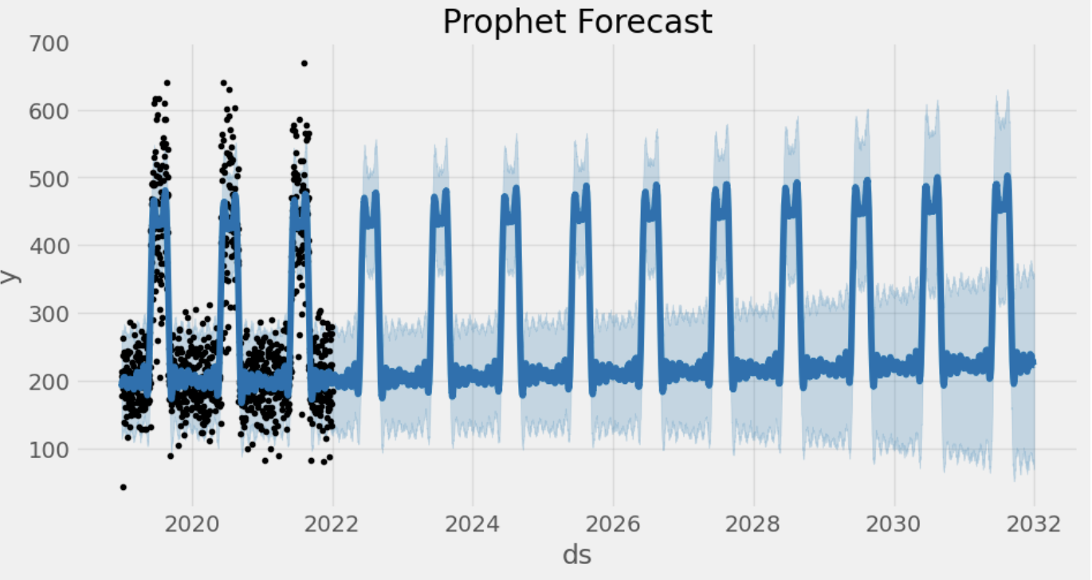
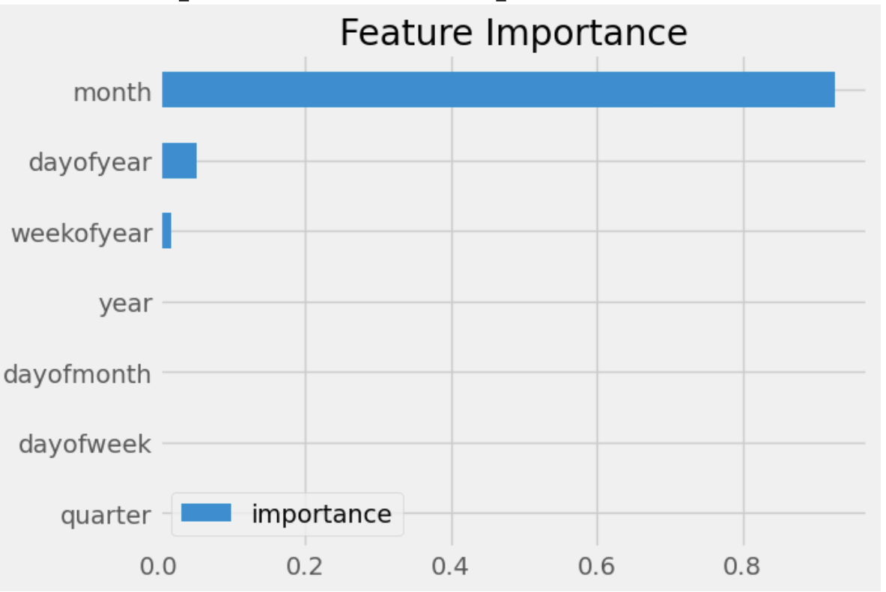
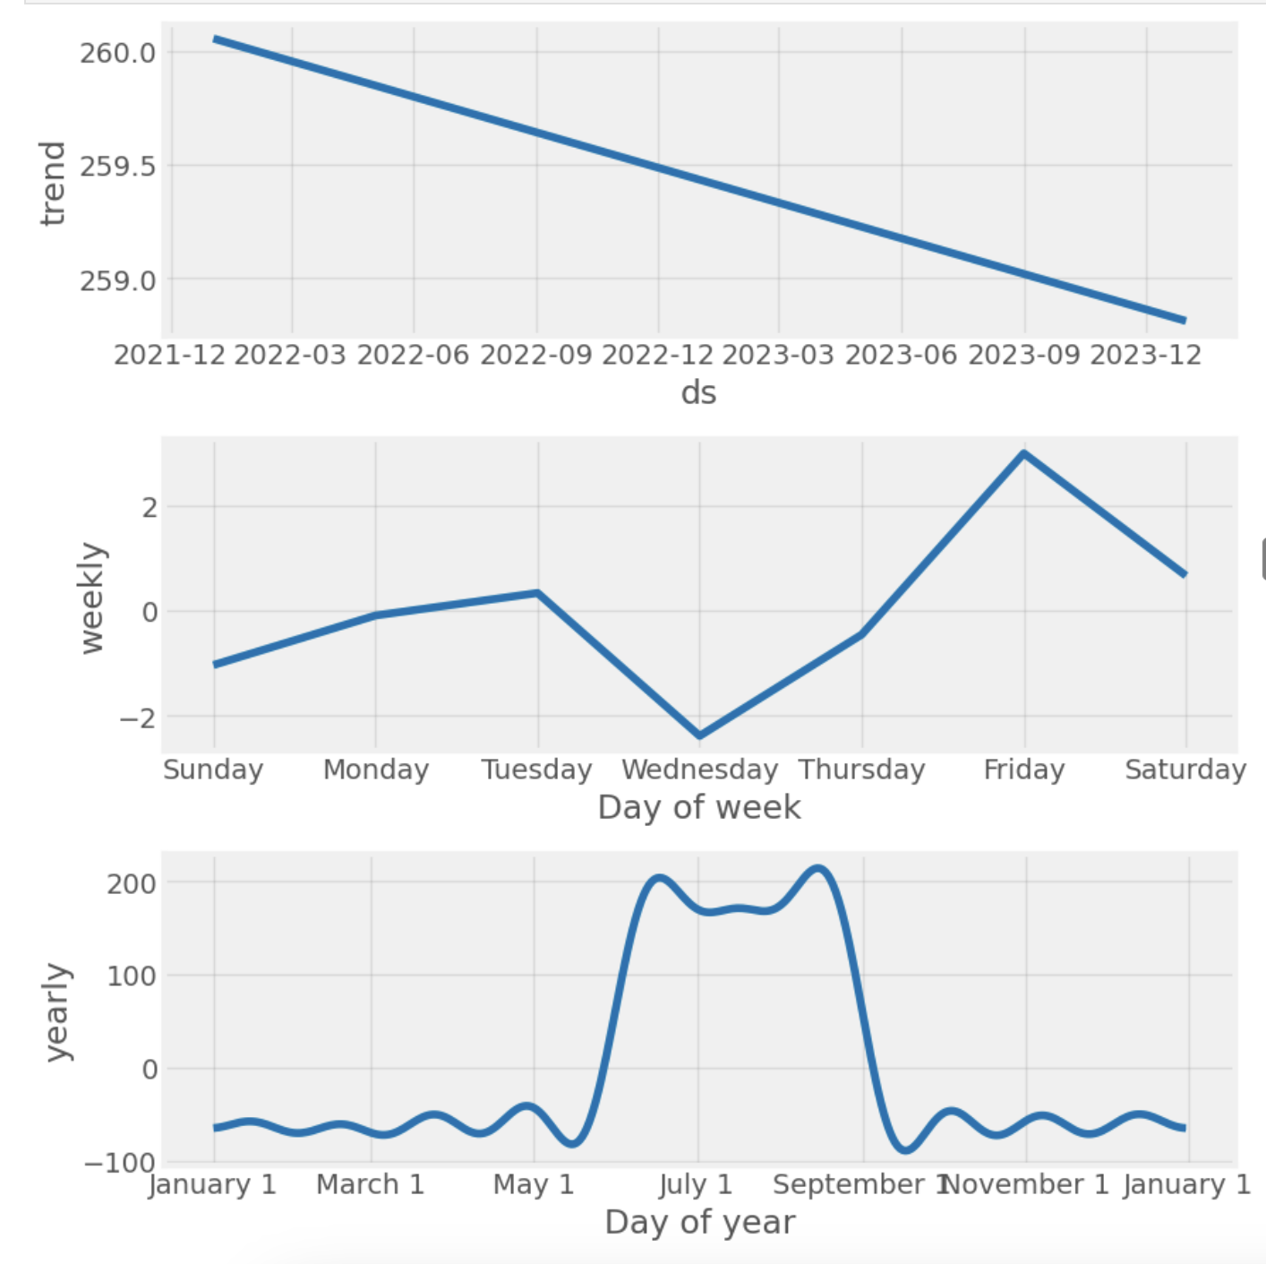
Skin Care
A Deeper Dive
Ten Year Forecast
Best Predictors for Unit Sold
There is a negative trend which demonstrates decrease in sales. Seasonality analysis highlights rise in sales during summer months.
02
Annual sales are projected to remain constant within the next ten years, with the trend of sales peaking during summer being consistent.
Month of Year is the best predictor. Analysis suggests summer months(June- September) result in a huge uptick in sales.

Slide 8
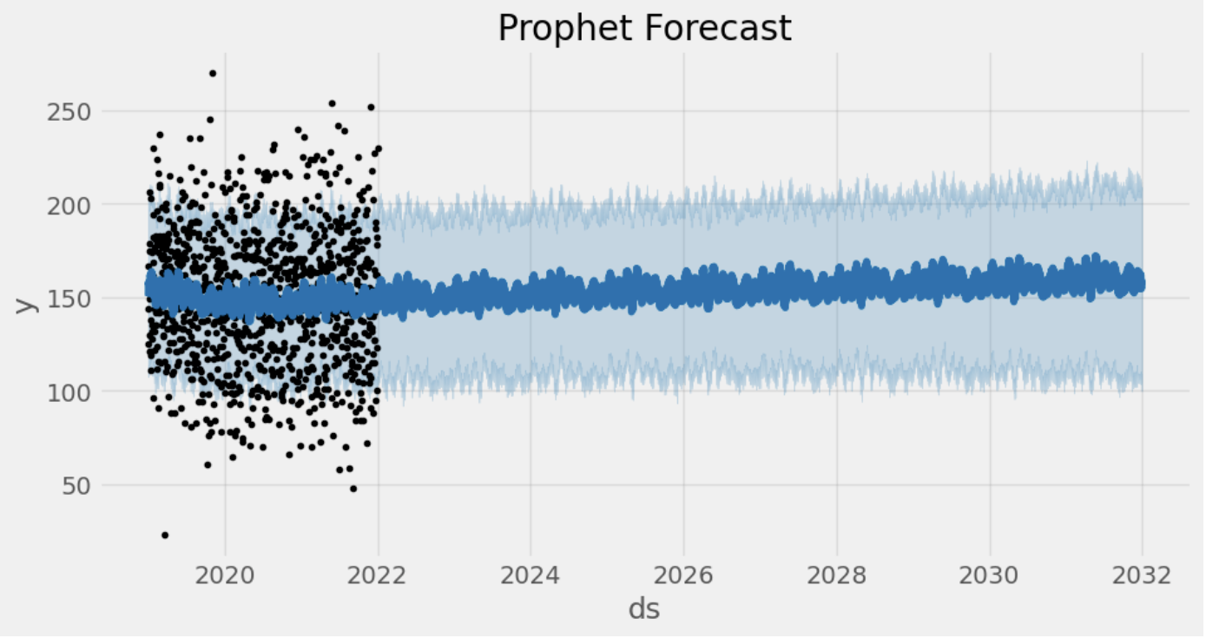
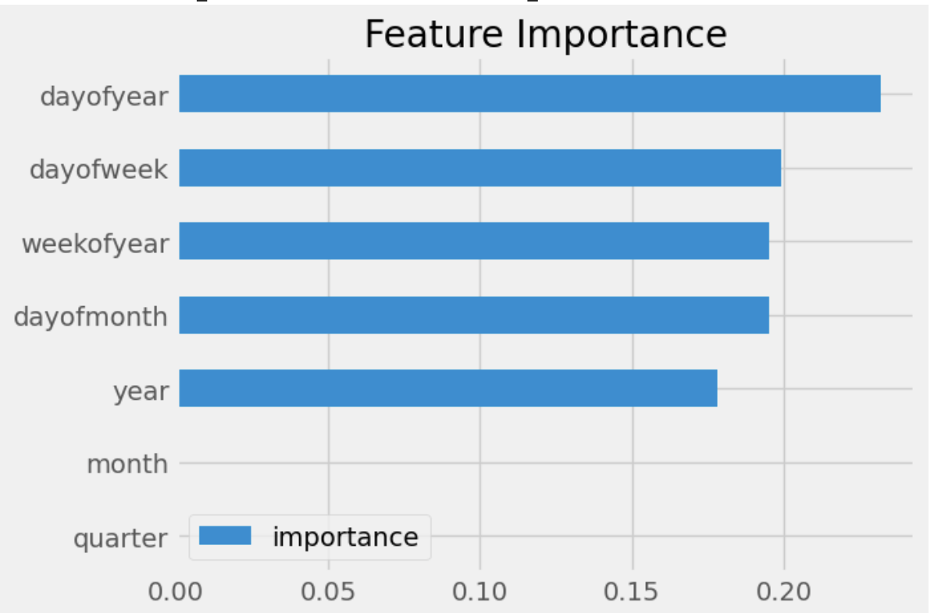
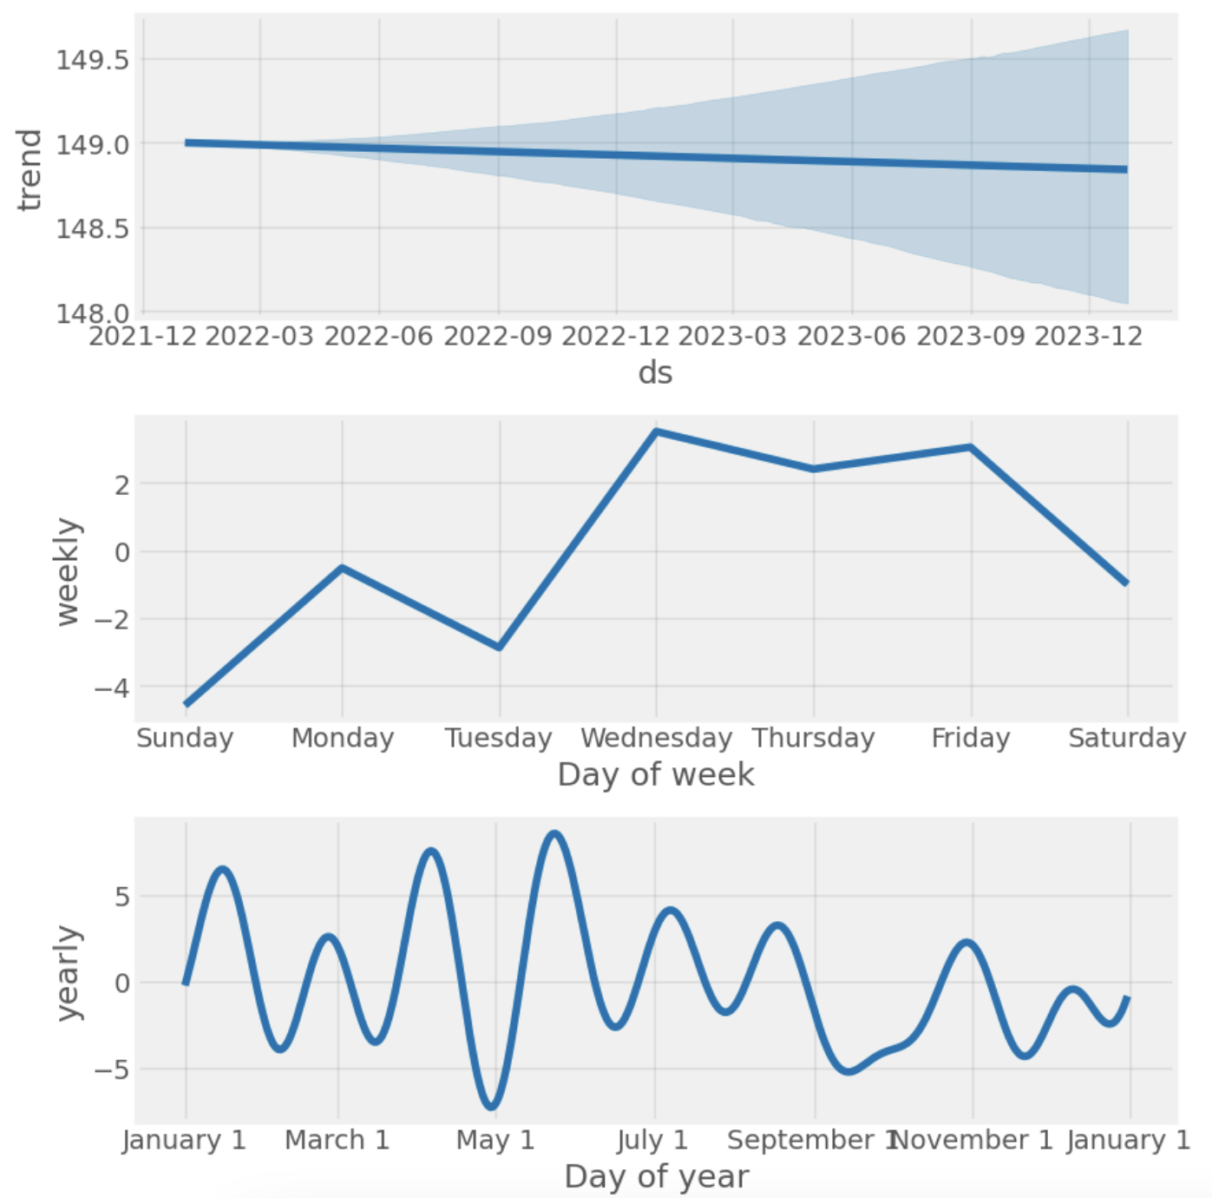
First Aid Supplies
A Deeper Dive
Ten Year Forecast
Best Predictor of Units Sold
There is a strong, flat trend which demonstrates stagnation in sales. There is no seasonality, highlighting that sales remain consistent throughout the year.
02
Annual sales are projected to slightly increase within the next ten years, with the trend of sales having no seasonality being consistent.
As all the features have relatively equal feature importance, there is no clear seasonality in pharmacy sales.

Slide 9
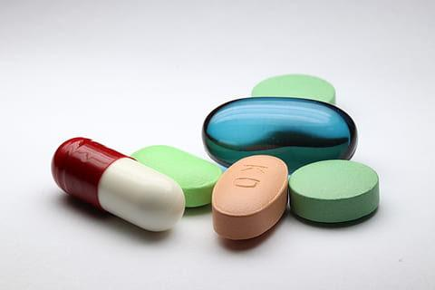
Business Recommendations

Slide 10
Insights Overview
Pain relievers have a positive trend, signifying growth in this drug category.
1
First aid and vitamins have a stable projected trend, signifying areas of improvement for growth in sales for these categories.
3
2
Most worrying categories are cold medicines and skin care, which have a negative trend, though not very pronounced.

Slide 11
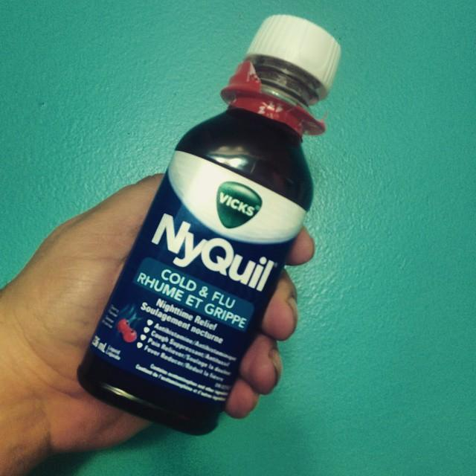
Cold Remedies Market Trends and Recommendations
Seasonal Timing: Due to cold remedies sales peaking in winter, consider beginning to advertise cold remedies during waning summer months/fall months.
Cross-Selling: Cross sell cold remedies with pain relievers that peak around the same months (e.g. create value bundles of advil + tylenol).

Slide 12
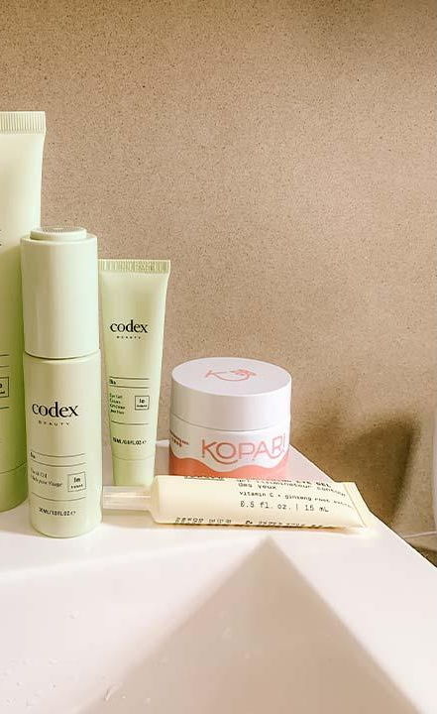
Skin Care Market Trends and Recommendations
Marketing Strategies: Skin care sales peak during the summer likely due to popularity of outdoors activities. Linking skin care products to these outdoor activities could lead to increased sales.
Diversify Inventory: Sell or promote more non-seasonal medicines such as acne medications that must be used year-round, which could lead to more returning skin product customers.

Slide 13
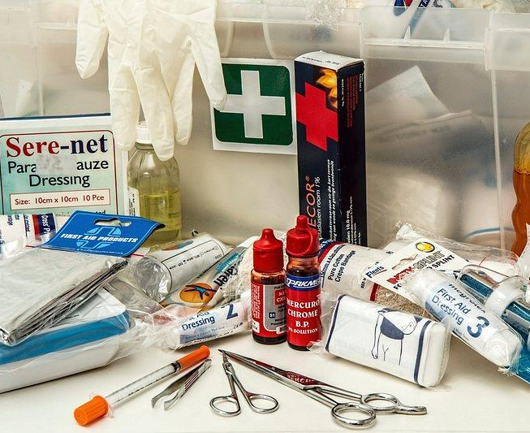
First Aid Market Trends and Recommendations
Value-Bundling: Create more first-aid kits that are versatile for multiple situations and contain different first-aid supplies(e.g. Combine band-aids, alcohol wipes, etc.).
Increase Appeal: Expand your selection of colorful, character-themed bandages and other child-oriented first aid supplies. This strategic inventory boost can give your pharmacy a competitive edge, as children are frequent users of these products. By offering fun and appealing options, you'll attract families and potentially increase customer loyalty.

Slide 14
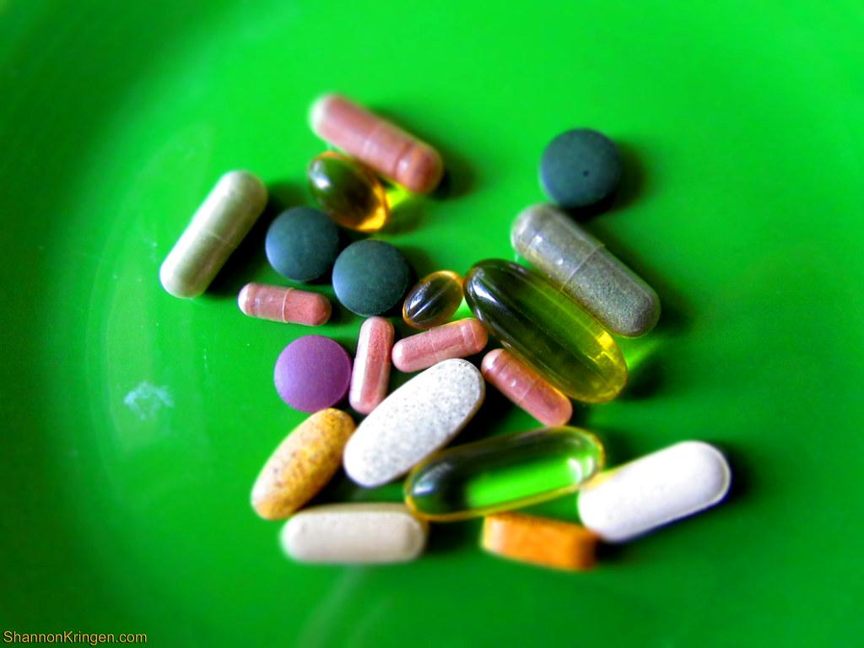
Vitamins Market Trends
And Recommendations
Seasonal Advertising: While vitamins peak every new year, advertising vitamins based on weather changes could result in consumers purchasing more vitamins throughout the year.
Cross-Selling: Vitamins peak in accordance with cold remedies and pain relievers. Creating value-bundles between these categories could increase sales due to popularity of other two products.

